Slide 1
Business and Industrial Economics
A.Y. 2023/2024
Prof. Mattia Pedota
Firm Growth: Internationalization

Slide 2
Firm boundaries
3. Vertical
3.1 Backward
3.2 Forward
1. Horizontal 2. Lateral
2.1 Related diversif.
2.2 Unrelated diversif.
4. International
3.1
Mozzarella
factory
4
Importing tomato sauce
2.2
Department store
2.1
Burger restaurant
Pizza restaurant
1
Pizza restaurant
4
Pizza restaurant in NYC
3.2
Home delivery

Slide 3
The internationalization process: stylized facts
60’s
90’s
Today
Offshoring of production
Offshoring of business functions (e.g. call centers)
Global sourcing of high value-added activities (e.g. R&D; Design, Product Development)
Enablers?
Improved coordination and recombination capabilities due to advances in ICT
Modularization and standardization of complex tasks
Improvement in the capability of emerging economies

Slide 4
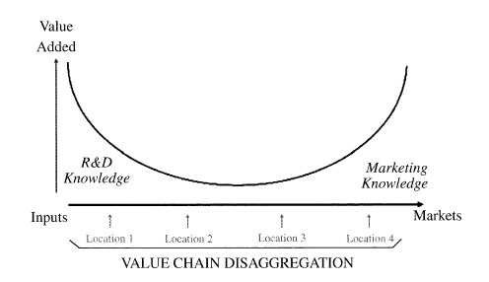
The internationalization process: stylized facts
The smiling curve of value creation (MNEs, knowledge and location)
Advanced countries
Developing countries
Advanced countries
(Source: Mudambi, 2007, p. 206)

Slide 5

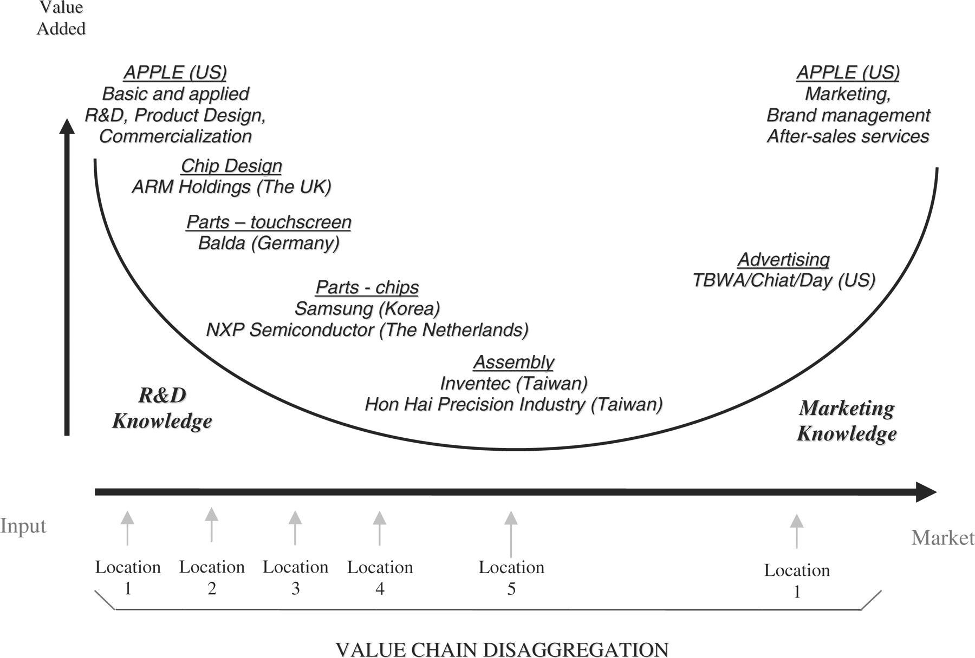
The internationalization process: stylized facts
Example
(Source: Mudambi, 2008, p. 711)

Slide 6
The internationalization process: stylized facts
60s-80s | Today
Manual and labor intensive | Technology and capital intensive (the impact of ICT)
Orientation towards production | Orientation towards customers
One product | Product diversification
National business context | International business context
Long product life cycle | Short product life cycle
Loyal customers | Unstable and demanding customers’ needs
Mere profit maximization | Greater attention towards social, environmental and ethical issues

Slide 7
The internationalization process: stylized facts
After offshoring, some companies decide to re-shore, backshore and near-shore their activities
Why?
Changes in priorities (e.g. cost vs differentiation)
Emergence of technological enablers (e.g. 3D printing)
Managerial mistakes

Slide 8
The internationalization process: definitions
Internationalization: firm involvement beyond the home country boundaries
Export (simple trade flows between countries)
Intermediate forms granting indirect presence in other countries (e.g. some types of licensing agreements and strategic alliances)
Foreign Direct Investment (FDI): establishment of a controlling interest into another country
Greenfield investments (new firm from scratch)
Joint ventures (when the third entity being created is abroad)
Acquisitions (purchase of an existing local firm)
Firms engaging in Foreign Direct Investments (FDI) are called Multinational Corporations (MNCs) or Multinational Enterprises (MNEs)

Slide 9
Economic Theories of MNCs
Hymer’s seminal contributions
Dunning’s eclectic paradigm
Verbeke’s dynamic framework

Slide 10
Economic Theories of MNCs
Before 1960s (i.e. before Hymer’s seminal work) several economists investigated international trade (export)
These theories regarded trade and capital movements across borders (not FDI):
the main determinant of movements of goods (trade) across borders is the difference in factor endowments
the main determinant of movements of funds (capital) across frontiers is the difference in interest rates

Slide 11
Hymer’s seminal work
Hymer (1960s) distinguishes between:
Portfolio Investments (purely financial investments)
Exports
Foreign Direct Investments (FDI) providing the firm control over the business activities abroad
FDI are the essence of the internationalization process: while exports are simple market transactions, FDIs allow firms to grow internationally

Slide 12
Hymer’s seminal work
FDI involves extra costs and risks (what Zaheer (1995) has defined the “liability of foreignness”):
Costs of communication and acquisition of information in a different cultural, linguistic, legal, economic and political context
Costs of international coordination
Costs due to less favorable treatment given by host countries’ governments
Risk of exchange rate fluctuations
→ The MNC’s competitive advantage must be so strong as to overcome the liability of foreignness

Slide 13
Dunning’s Eclectic Framework
Synthesis of previous approaches to study why firms become MNCs in a comprehensive framework
The degree and structure of foreign activities depend on the existence of 3 types of advantages:
Ownership advantages (firm-specific factors of competitive advantage)
Location advantages (advantages inherent in the chosen location)
Internalization advantages (reasons why it is better to conduct the activity inside the firm than otherwise)
→ OLI eclectic paradigm

Slide 14
Dunning’s Eclectic Framework
The drivers of international expansion:
Resource seeking: search for cheap or productive resources
Market seeking: search for new markets
Efficiency seeking: international division of production aimed at increasing efficiency through selective exploitation
Asset seeking: development of international presence aimed at acquiring strategic assets

Slide 15
Dunning’s Eclectic Framework
Problems:
The original eclectic paradigm is static model
It is well-suited to give a snapshot of the drivers of internationalization, but it fails to account for expansion dynamics
It doesn’t consider the evolution of resources and capabilities thanks to international presence
Renewal of competitive advantage is neglected

Slide 16
Verbeke’s dynamic framework
Main components:
Internationally transferable firm-specific advantages (non-location-bound FSAs)
Non-transferable firm-specific advantages (location-bound FSAs)
Location advantages
Resource recombination, and value creation through it
Complementary resources of external actors
Bounded rationality
Bounded reliability

Slide 17
Verbeke’s dynamic framework
Non-location bound FSAs, location-bound FSAs and location advantages refer to the bundle of resources in the firm’s possession.
They can be distinguished based on
Mobility (transferable vs non-transferable)
Availability (firm-specific vs location-specific)
Location advantages can be exploited by any firm operating in that location. However, they do not benefit every firm in the same way
By expanding internationally, a MNE relinquishes its location-bound FSAs and its home country location advantages. However, it benefits from the host country location advantages

Slide 18
Verbeke’s dynamic framework
Recombination and complementary resources of external actors capture dynamic features such as innovation, adaptation and evolution
Complementary external resources may be needed for effective deployment of FSAs, especially in the initial phases of the expansion (dynamic adaptation)
Resource recombination is essential to reinvigorate the MNE’s competitive advantage, developing new resources and capabilities by selectively integrating existing ones with newly acquired ones
Skillful resource recombination leads both to the upgrading of existing (non-location-bound and location-bound) FSAs and the development of entirely new ones

Slide 19
Verbeke’s dynamic framework
Bounded rationality and bounded reliability capture uncertainty
The concept of bounded reliability is very broad: besides including opportunism intended as “self-seeking interest with guile” (Williamson, 1979), it includes sources of benevolent preference reversal, such as reprioritization in good faith and failure to deliver on overcommitments

Slide 20
Verbeke’s dynamic framework
Advantages of the framework
It highlights the importance of the transferability of (some) FSAs abroad and their degree of complementarity with the host-country location advantages
It accounts for environmental complexities (not only bounded rationality, but also bounded reliability)
It captures international determinants of the evolution of competitive advantage over time

Slide 21
Verbeke’s dynamic framework
To sum up
Consider carefully the interplay between firm-specific (ownership) and location advantages before expanding internationally
Be aware you may need to borrow complementary resources, especially in the first phases
Modern internationalization is mostly about strategic positioning: do not adopt a short-term exploitation-oriented vision, but consider the possibility to tap into heterogeneous sources of knowledge and recombine them
Do not forget about bounded rationality, bounded reliability and the liability of foreignness

Slide 22
R&D sites in IB
Traditionally, knowledge is mainly generated in R&D sites:
Home-base augmenting sites: sites designed to augment the R&D capabilities of the MNE by absorbing knowledge in strategic locations and transferring it to the home base.
Home-base exploiting sites: sites designed to exploit the R&D capabilities of the firm by transferring key knowledge from the home base to the foreign R&D site and from there to local manufacturing and marketing.

Slide 23
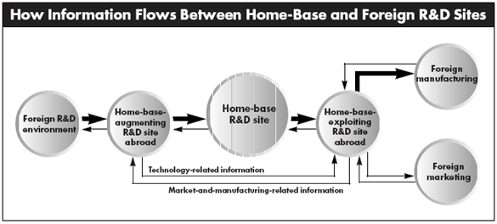
R&D sites in IB

Slide 24
AI and IB
AI reduces the sources of uncertainty plaguing IB.
Bounded rationality: AI decreases bounded rationality by strengthening firms’ ability to gather and synthesize information about the present world and predict its future states.
Bounded reliability: AI decreases bounded reliability by bringing down search and monitoring costs and by reducing the sources of benevolent preference reversal.
At the same time, it makes it easier to find and integrate complementary resources of external actors, by facilitating the identification of resource (particularly knowledge) gaps.

Slide 25
AI and IB
AI generates a series of new key FSAs:
The ability to accumulate and leverage AI-relevant knowledge
The ability to accumulate, leverage and maintain a heritage of structured and unstructured data, which is dynamically re-assessed as new data become available.
The development of high-level capabilities like orchestrating data acquisition from internal and external sources, positioning in strategic data sharing networks, and implementing data integration frameworks.
The development of corresponding low-level routines such as data crawling and web scraping.
The ability to combine knowledge sourced by traditional means with knowledge generated through AI-driven data elaboration.

Slide 26
AI and IB
AI enables more accurate and fruitful location choices, by improving:
The estimation of location advantages.
The identification of resource and capability gaps.
The identification of complementarities between internationally transferrable FSAs and location advantages.
The dynamic adaptation to local peculiarities.
The speed and quality of knowledge flows throughout the MNE

Slide 27
AI and IB
On the one hand, home-based augmenting sites become even more important.
Sourcing of data compounds sourcing of knowledge.
The possibility to virtualize tacit knowledge makes knowledge (and) data sourcing even more relevant, as knowledge can be more effectively diffused throughout the MNE.

Slide 28
AI and IB
On the other hand, the distinction between home-based augmenting and home-base exploiting sites is likely to become more blurred.
The possibility to extract valuable insights from manufacturing, marketing, and operations endows even exploiting sites with the capability to augment the MNE’s overall knowledge base and data heritage.
Bidirectionalities become more prominent, as AI is capable of uncovering hidden patterns in heterogeneous data. Thus, the knowledge feedbacks from exploiting sites to the home-base R&D sites become more valuable (especially when aggregated).

Slide 29
AI and IB
However, lack of adequate complements has dangerous consequences
Biased datasets entail biased internationalization choices.
Global competition is highly dynamic: failure to update and reconfigure algorithms as external conditions evolve may lead to costly mistakes.
Despite its huge analytic and creative potential, AI often lacks context and cross-domain sensitivity. Managers should maintain a positive but critical stance on AI outcomes, aiming to complement them rather than take them at face value.
Lack of AI-relevant knowledge, domain-specific knowledge, data of adequate number and variety, and/or cognitive ambidexterity may severely limit or even revert the enhancing potential of AI.

Slide 30

Questions?

Slide 31
References
Besanko et al. (Economics of Strategy), Chapters 3 & 4
Ietto-Gilles (2012), Chapters 4 – 11.
International Business Strategy 2nd edition (Verbeke): Part 1 – core concepts

